Slide 1
Paired Wilcoxon-signed-rank test
CAS Applied Data Science
David von Holzen und Mayra Spizzo
30.08.2024

Slide 2

Purpose, assumptions & procedure
Purpose:
Compare two related samples
Non-Parametric (alternative to the paired t-test)
Assumptions on data:
Paired or matched (e.g. 1 indivdual at 2 different time points)
Non-normal distribution
Symmetric
Ordered metric scale
Procedure:
Calculate differences (e.g. value before/after treatment)
Rank differences
Assign signs to ranks (+/-)
Sum the ranks
Test statistics (H₀: Diff. paired Obs. = 0)

Slide 3


Example to apply the test
Blood pressure before and after the treatment with a drug
Does the drug help to decrease the blood pressure?
H₁: The blood pressure at time 2 is lower than the blood pressure at time 1.
Time 1
Blood pressure being measured
Time 2
Blood pressure being measured

Slide 4
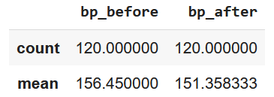
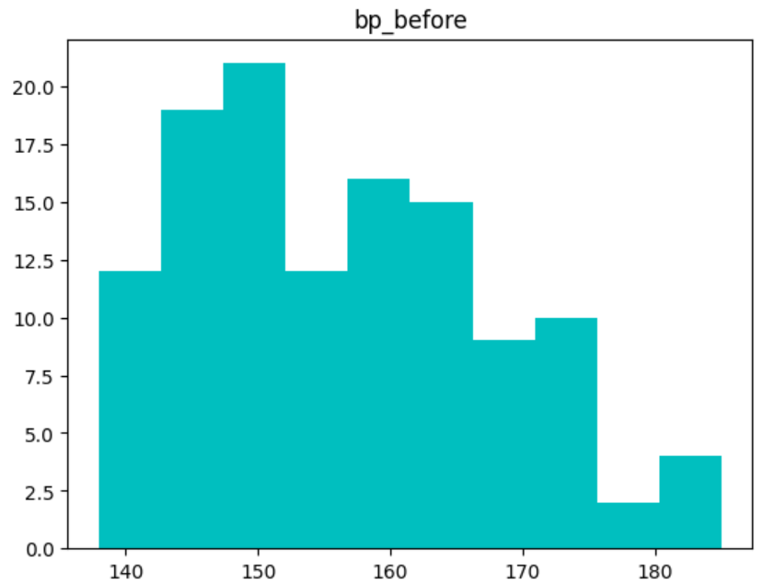
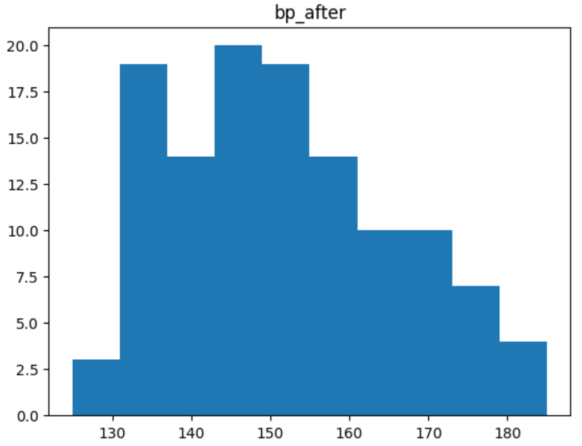
Implementation in python
Variables of interest
Check for normality
Conduct the test
Result
stats.wilcoxon(df['bp_before'], df['bp_after'], alternative='greater')
x
y
Options: 'two-tailed', 'less', 'greater'
"x is greater than y"

